Slide 1
North East LIPF project development: Q&A drop-in session
26th March 2026

Slide 2
Agenda
Introduction & process to date (15 mins)
Q&As (45 mins)
Networking (1 hour)

Slide 3
North East Local Innovation Partnerships Fund (LIPF): Introduction & process to date

Slide 4
Local Innovation Partnerships Fund (LIPF)
A new, UKRI-led national programme that will invest up to £500 million over five years to develop and scale high-potential innovation clusters across the UK.
North East amongst the 10 “Earmarked Strand” regions to receive up to £30m funding.
The funding is not devolved to the CA - we are working in partnership with UKRI and regional stakeholders on the development of a project portfolio to unlock the funding.
LIPF development process has been overseen by the North East Local Innovation Steering Group (triple-helix partnership) in line with the LIPF criteria.
The Steering Group has nominated the North East CA as the Lead Bidder for the LIPF, and we have launched an open call for projects to inform the project portfolio.

Slide 5
LIPF project development process
Eligible activity
Research commercialisation
Adoption and diffusion of new technologies
Business growth / development initiatives
Translational R&D
Cluster development, networking and leadership
Talent and skills development
R&D infrastructure
Knowledge exchange and R&I networking
Seed corn funding
Access to / attracting overseas business and investment
See full details in the LIPF official guidance published by UKRI

Slide 6
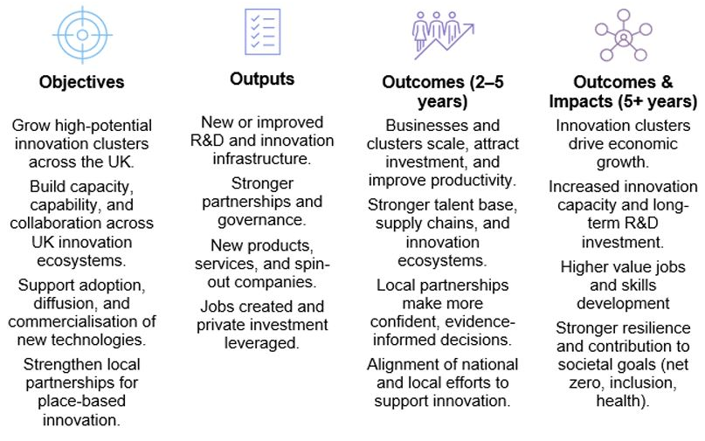
LIPF Project Objectives & Outcomes

Slide 7
LIPF projects - High-level summary of assessment criteria
LIPF project development process
Strategic fit | Focus on LIPF priority cluster (s) Alignment with NE Local Growth Plan, UK Industrial Strategy, and regional innovation objectives
Funding and leverage | Committed private matched funding
Eligible activity | Near-to-market research and innovation activity with strong potential for commercial application and industry adoption
Deliverability and impact | Deliverable within five years (starting 2026/27) Deliver scalable and long-term local economic impact (by increasing productivity, attracting investment, and creating high-value jobs)
Outputs and Outcomes | Tangible benefits (such as new products, services, jobs, and infrastructure) while strengthening the region’s innovation ecosystem
Full Applicant Guidance & UKRI LIPF full guidance should be read before project submission

Slide 8
LIPF call for projects - our strategic approach
LIPF project development process
Other key aspects informing project selection:
Alignment with LIPF criteria.
Approaching from a portfolio-wide perspective (to form a coherent portfolio that will synergise projects whilst supporting priority clusters).
Expecting approx. £5m – £10m of LIPF funding to be allocated for each project.
We will be seeking projects with a private to public funding ratio of more than 1:1 during the LIPF delivery period, and over 2:1 over the 7-year monitoring period – and ideally more.
Deadline: 11th April 2026

Slide 9
LIPF priority clusters
Materials innovation
Underpinned by applications of advanced sustainable materials and formulated products within advanced manufacturing and clean energy industries, enabling low carbon processes
Health innovation
Underpinned by new innovations in diagnostics, advanced therapeutics and drug discovery, including through the application of AI.
Space technologies
Underpinned by the integration and application of space-based communications, key technologies (inc. Radio Frequency, AI, cybersecurity, autonomous systems) and advanced materials electronics
Cluster definitions may be further refined based on project applications and UKRI feedback to better focus on specific technologies.

Slide 10
North East Innovation Projects Pipeline - EOI
Part of a North East CA-led exercise to build up a pipeline of impactful, regional innovation projects that may be able to benefit from funding and investment in future, outside of the current LIPF funding process.
Not to be completed by projects seeking LIPF funding.
Participation in this process does not guarantee future funding.
Organisations wishing to put forward propositions must complete and submit the relevant EOI form.
Deadline: Friday 29th May

Slide 11
Questions & Answers

Slide 12
Examples of FAQs to date
Eligible types of private sector co-investment
Is there a required ratio between cash investment into industrial project staff costs vs cash investment into projects?
Do required subsidy contributions count as co-investment?
Funding flow models & monitoring
How does LIPF funding flow to partners?
How will industrial co-investment be monitored?
IP ownership
Are there defined intellectual property rules under LIPF?
Cross-partner collaboration
How can we identify collaboration opportunities with partners within the wider ecosystem?

Slide 13
Networking

